Slide 1
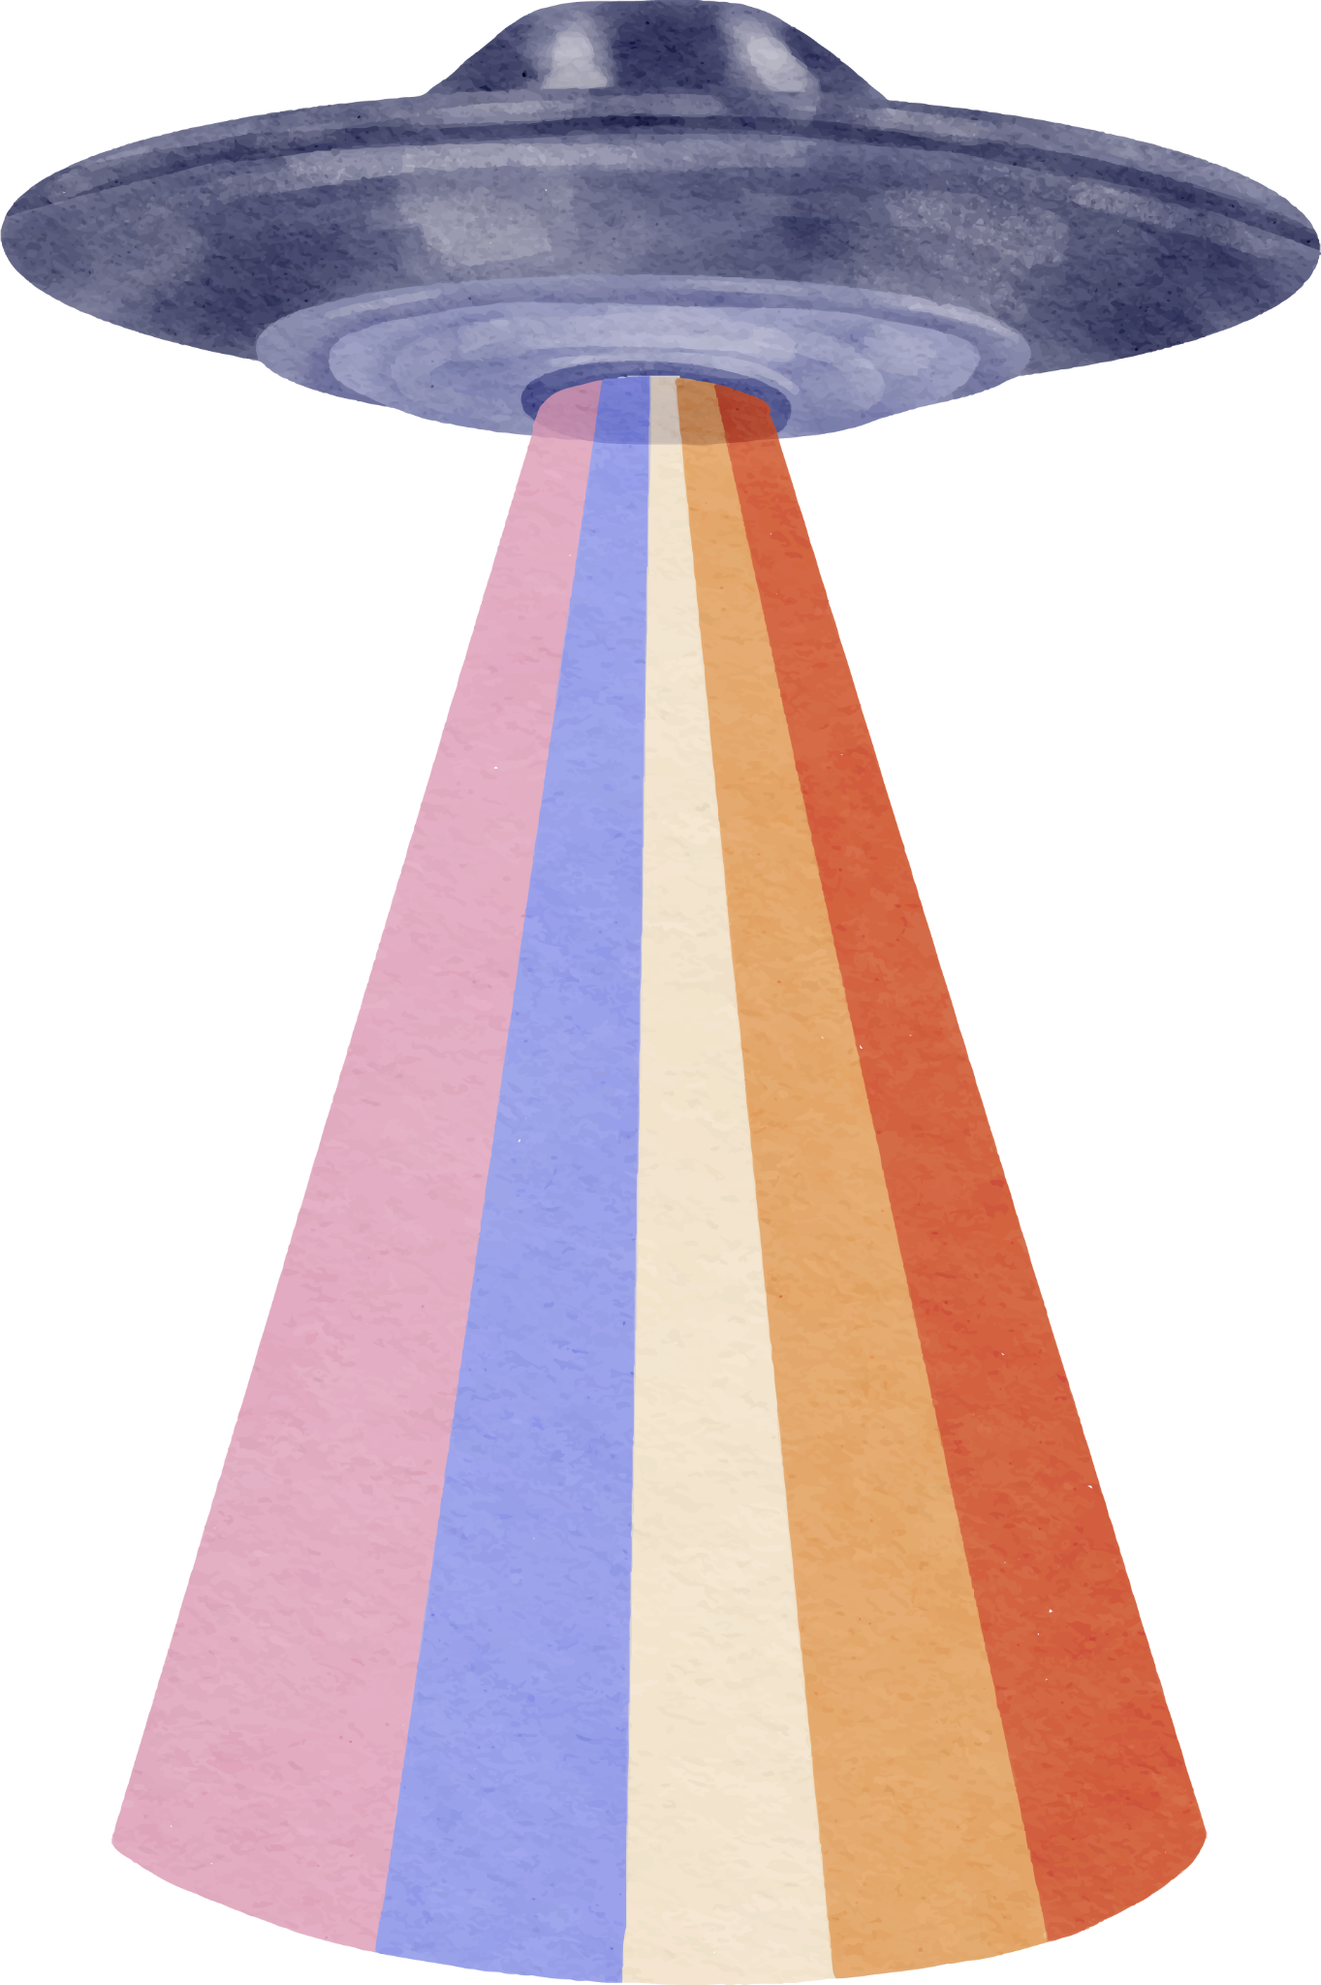

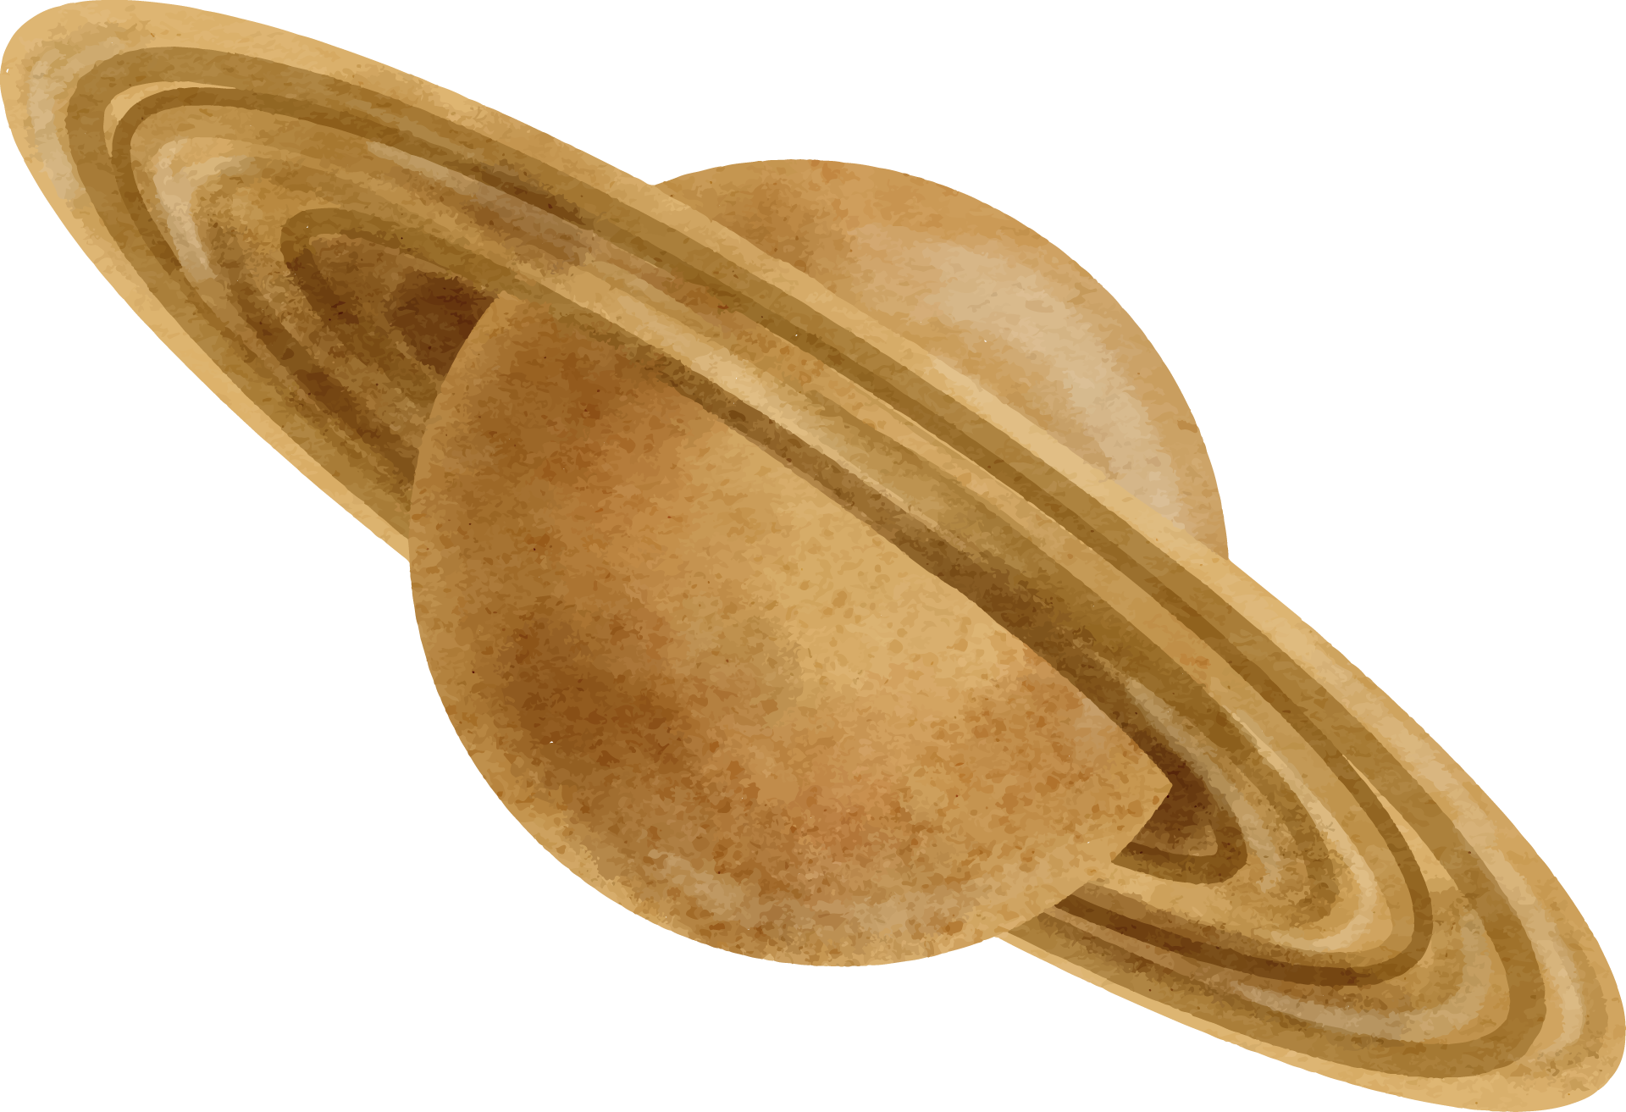

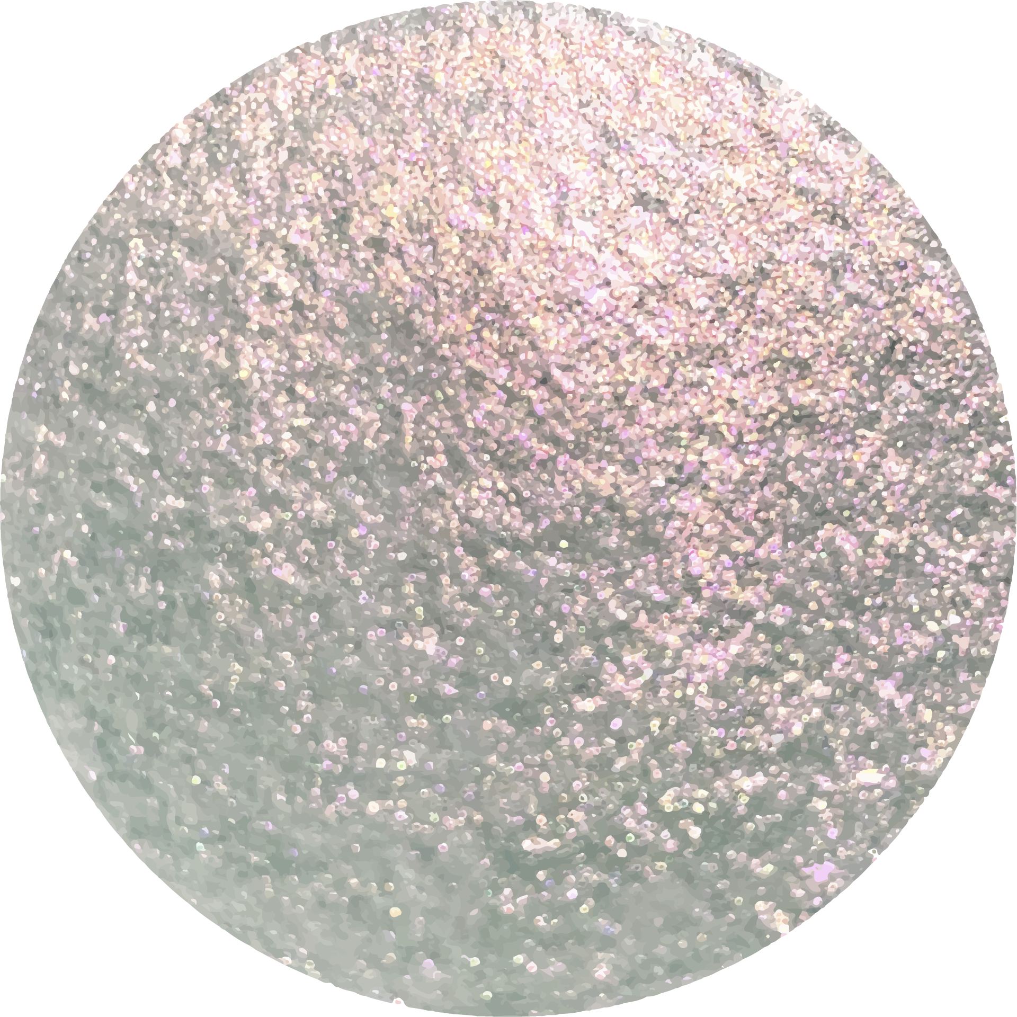
Domino
Game Project
A Console-Based Two-Player Domino Game
Author: Owen N Chilson
Date: 11/26/24
Notes:
Script: "Hello everyone, my name is Owen N Chilson, and today I’ll be presenting my Console-Based Two-Player Domino Game project. This project was developed in C++ and serves as a fun and interactive game where two players go head-to-head in a classic domino match. The key features include a shuffled deck, turn-based gameplay, and drawing mechanics, with the game ending when one player has no dominoes left. Let's dive into the details of the project!"

Slide 2
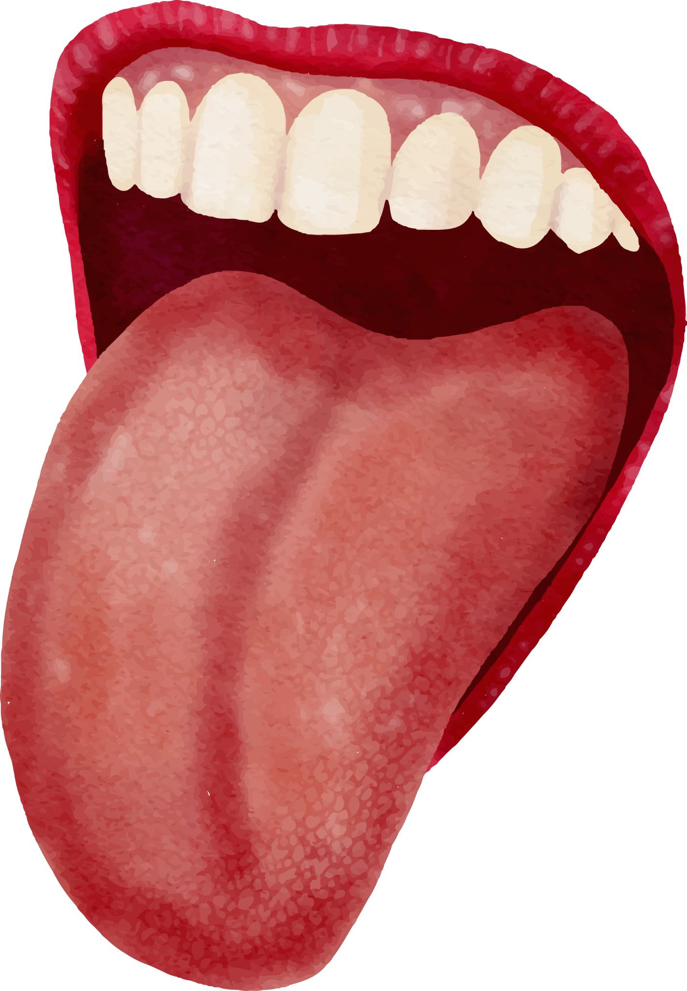
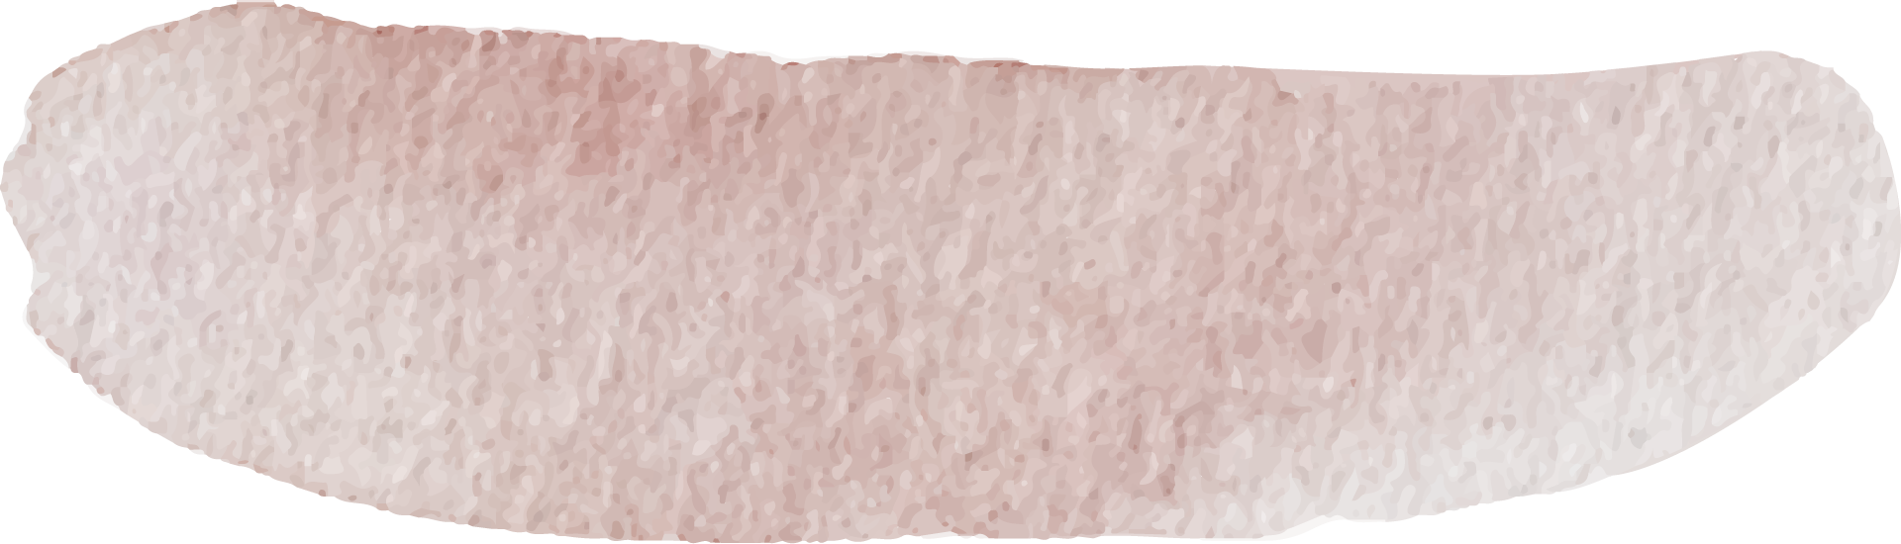
Project Overview
A two-player console game built in C++.
Key Features:
Random deck shuffling.
Turn-based gameplay.
Player drawing mechanics.
Win condition based on empty hand.
Notes:
Script: "Let’s start with a quick overview of the project. This game is designed as a console-based two-player domino game, built with C++. The core features include:
Random deck shuffling: Using a custom randomization mechanism to ensure fair gameplay.
Turn-based gameplay: Each player takes their turn to either play a matching domino or draw from the stack if they can't play.
Player drawing mechanics: If a player can't play, they can draw from the remaining dominoes.
Win condition: The game ends when one player has no more dominoes left in their hand.
These features come together to create an engaging experience for two players."

Slide 3
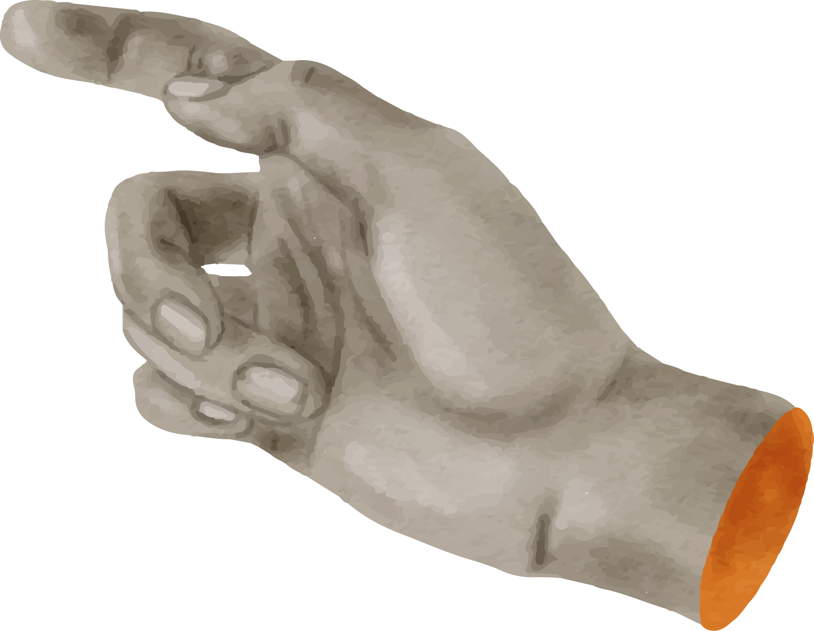

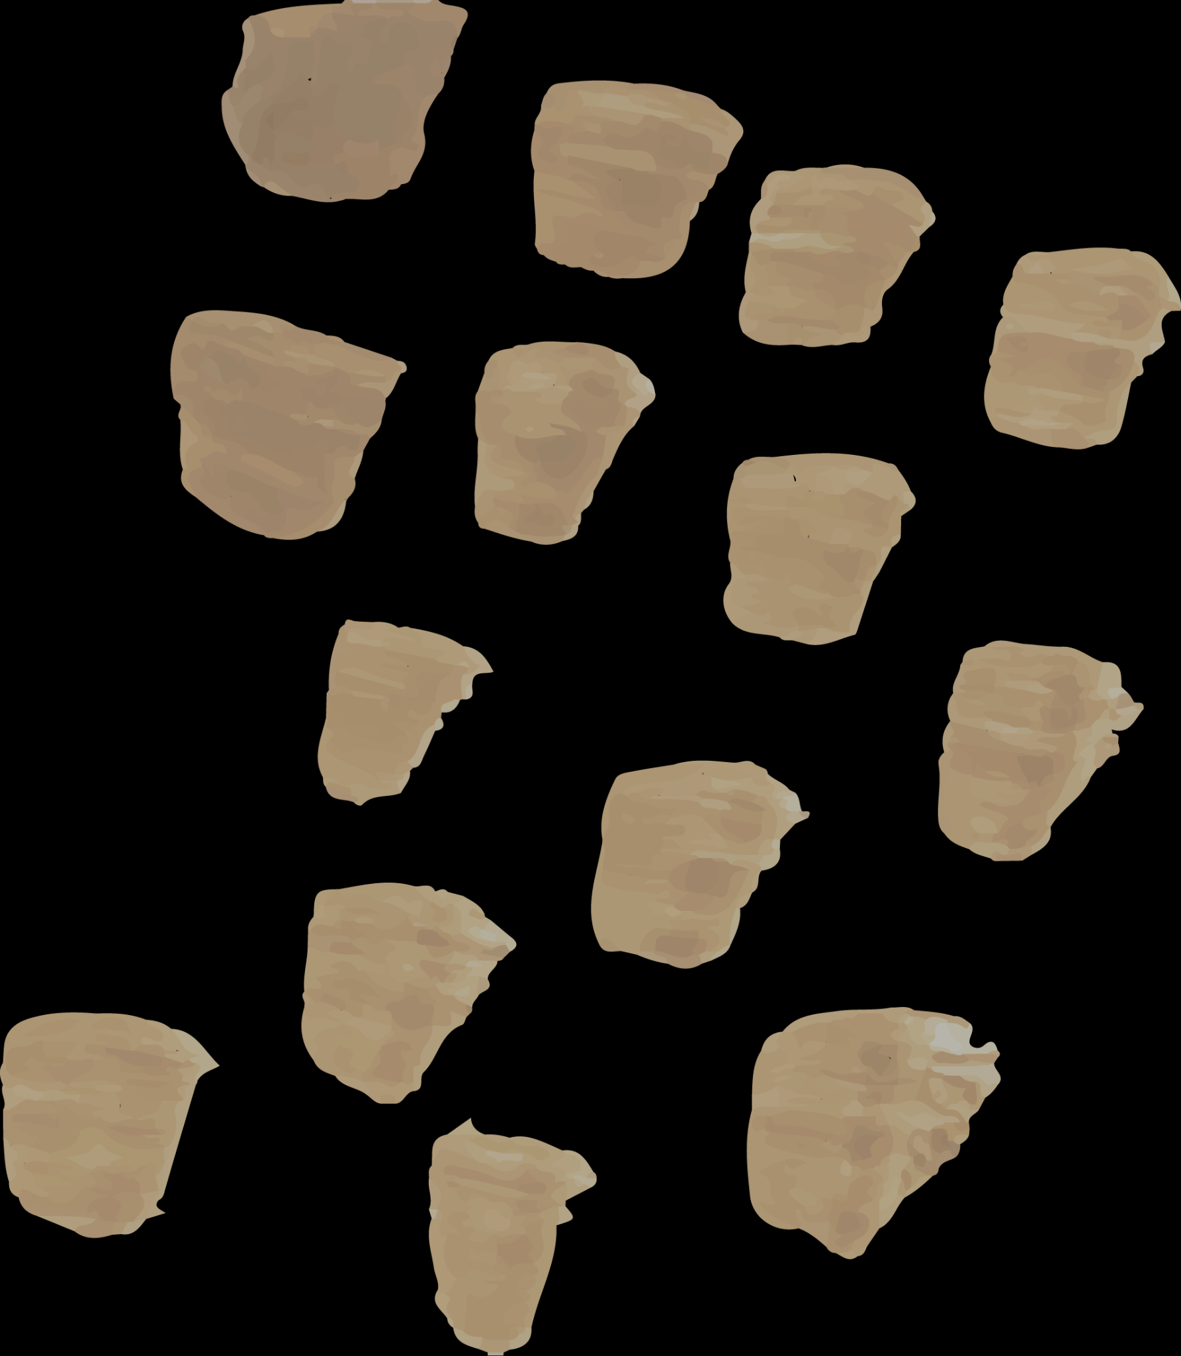
PROJECT STRUCTURE
01
CDominoGame
02
CPlayer
03
CTable
04
CRandom
Game logic and player turn management.
Manages player hands and interactions.
Handles domino placement on the board.
Utility for deck shuffling and random selection.
Notes:
Script: "Now, let’s take a look at the structure of the project. There are four key classes:
CDominoGame: This class contains the game logic and manages player turns.
CPlayer: Responsible for managing the player's hand and handling interactions such as playing and drawing dominoes.
CTable: This class manages the dominoes placed on the board. It ensures that dominoes are placed correctly at either end of the table.
CRandom: This utility class handles the shuffling of the domino deck and ensures that the dominoes are distributed randomly for each game.
Each of these classes plays a key role in the overall functioning of the game."

Slide 4

GAMEPLAY MECHANICS
Each player starts with 7 dominoes.
Turn-Based Rules:
Play a matching domino from your hand.
Draw from the stack if no match exists.
Skip turn if stack is empty.
Game ends when one player’s hand is empty.
Notes:
Script: "Let’s move on to the gameplay mechanics. Here’s how the game works:
Each player starts with 7 dominoes, drawn randomly from the deck.
Turn-based gameplay: On a player’s turn, they must play a domino that matches one of the numbers at the ends of the dominoes already placed on the board. If they can’t play, they will draw a domino from the stack.
Drawing mechanics: If no valid domino is available to play, players can draw from the stack. If the stack is empty, the player’s turn is skipped.
The game ends when one player has no dominoes left, declaring them the winner.
The game continues with players alternating turns until the win condition is met."

Slide 5
TECHNICAL HIGHLIGHTS
THREAD SAFETY
Mutexes protect shared resources like the table. Ensures both threads can run without conflicts.
RANDOMIZATION
Deck shuffled with custom CRandom class to ensure a random uniform distribution.
Notes:
Script: "Let’s now discuss some of the technical highlights of this project. First, randomization is a crucial feature. The deck of dominoes is shuffled using a custom CRandom class, ensuring a uniform and random distribution each time the game is played. Second, thread safety is implemented using mutexes to protect shared resources, such as the table, during gameplay. This allows the game to run without conflicts between multiple threads, ensuring smooth interactions even with multiple users playing the game concurrently.
These technical features help maintain the integrity and fairness of the game."

Slide 6
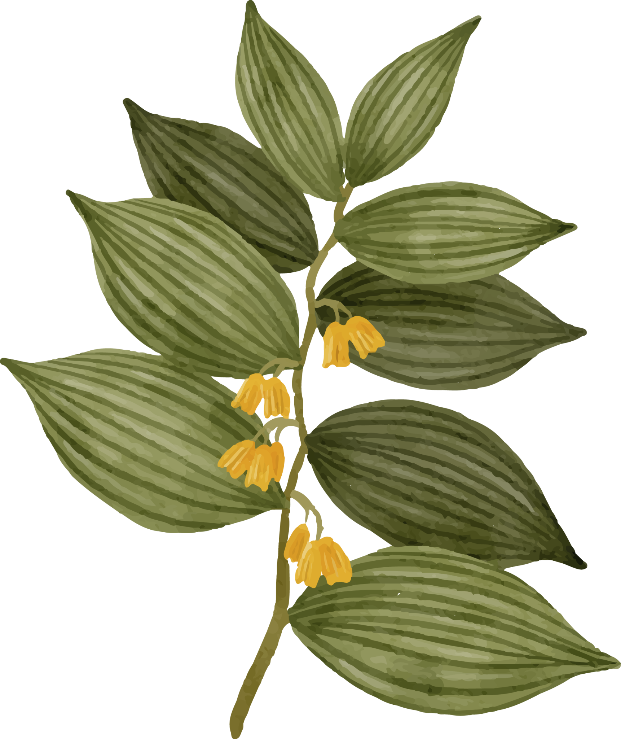

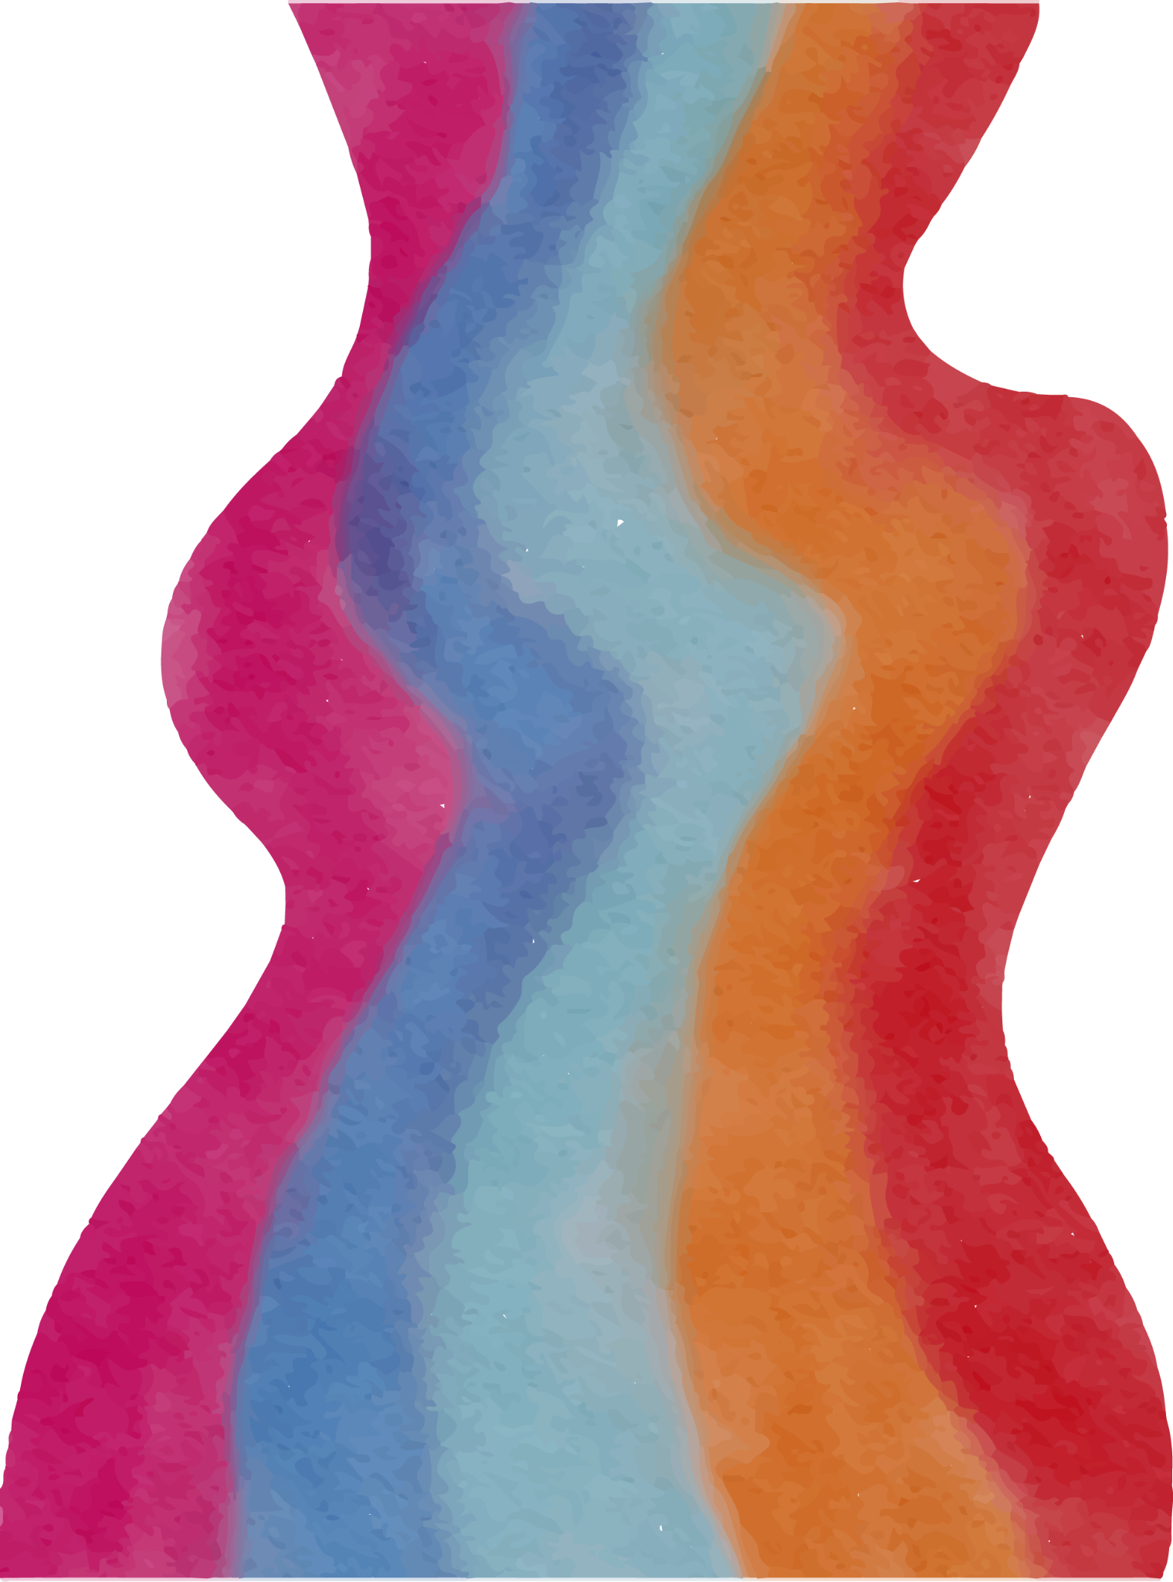
PRIMARY CHALLENGES
Thread Safety
Input Validation
DOMINO PLACEMENT
With no prior experience in multi-threading or mutex it took a while to familiarize myself.
Ensures valid moves and player actions was a challenge to handle all cases.
Ensuring valid domino placement by checking both ends of the table and flipping dominoes when needed.
Notes:
Script: "Like any project, there were challenges along the way:
Thread Safety: As this was my first experience with multi-threading and mutexes, it took a bit of time to familiarize myself with how to protect shared resources and avoid conflicts between threads.
Input Validation: Ensuring that players can only make valid moves was another challenge. I had to implement comprehensive checks to make sure players couldn’t make illegal moves.
Domino Placement: A key challenge was ensuring dominoes were placed correctly. The game checks both ends of the table to make sure the dominoes fit, and it also accounts for flipping dominoes when needed."

Slide 7
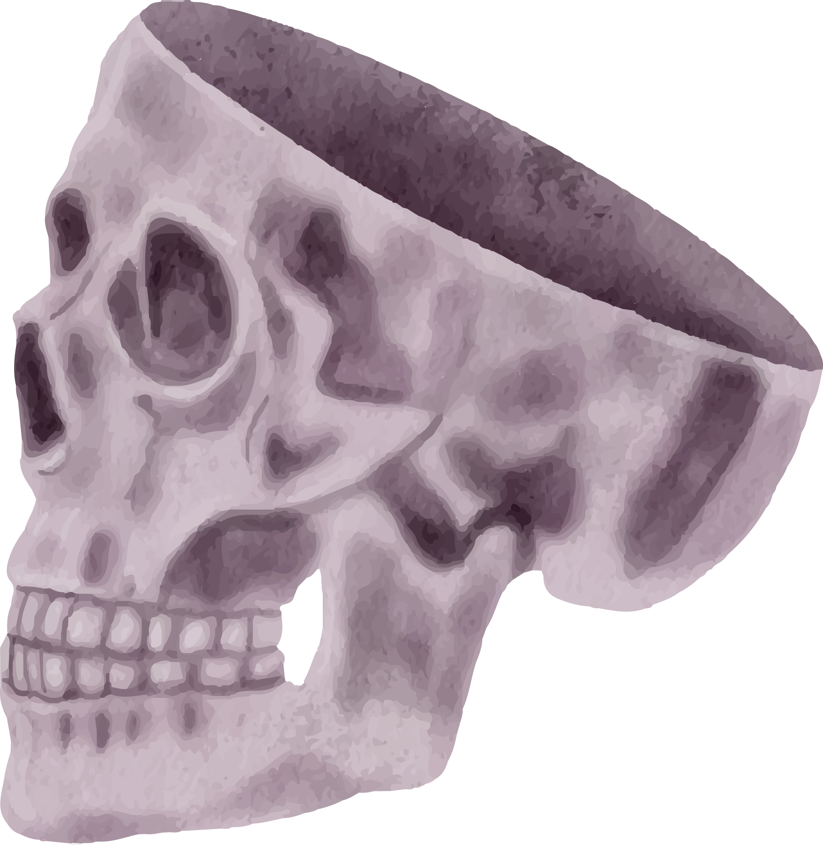
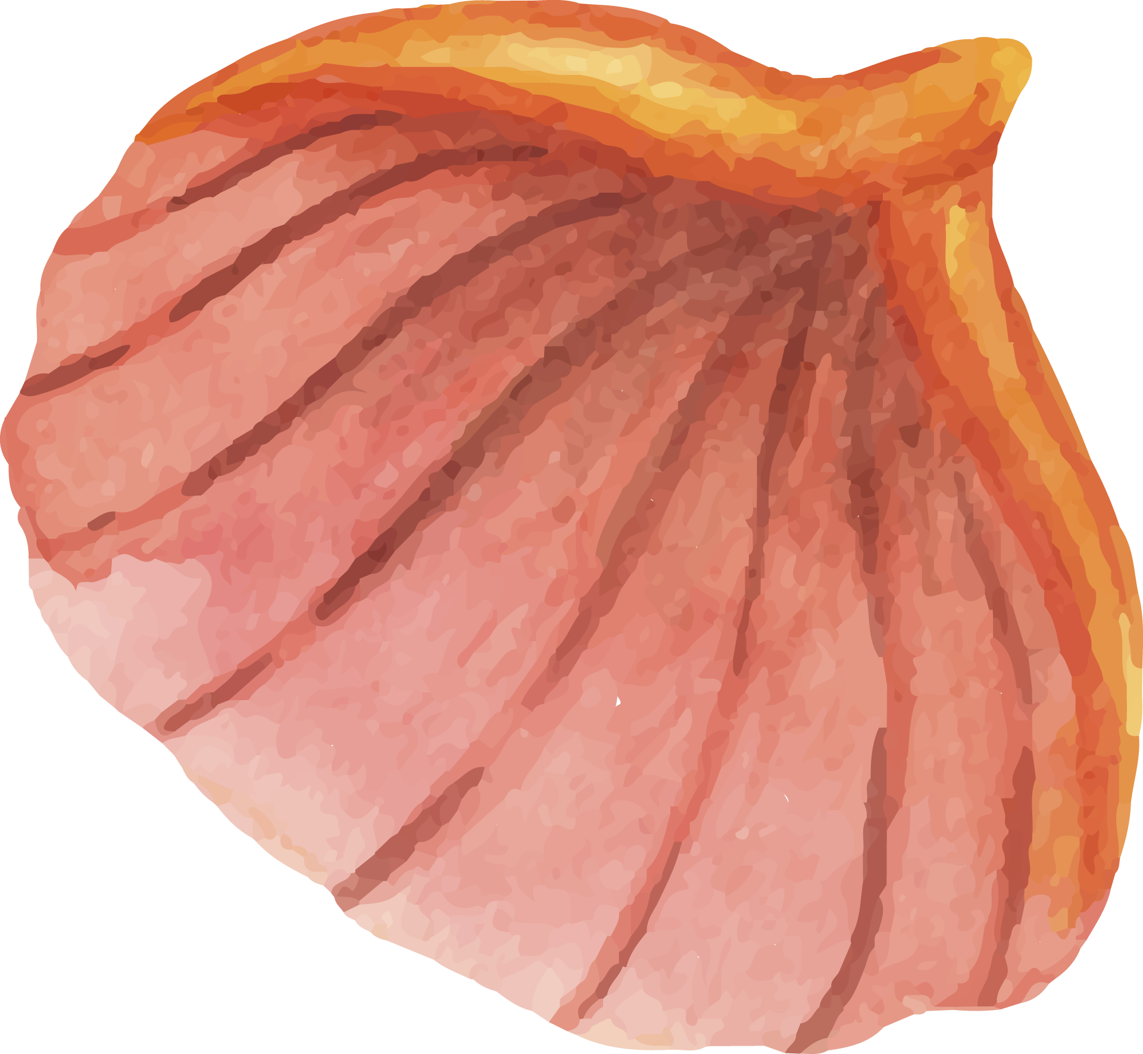
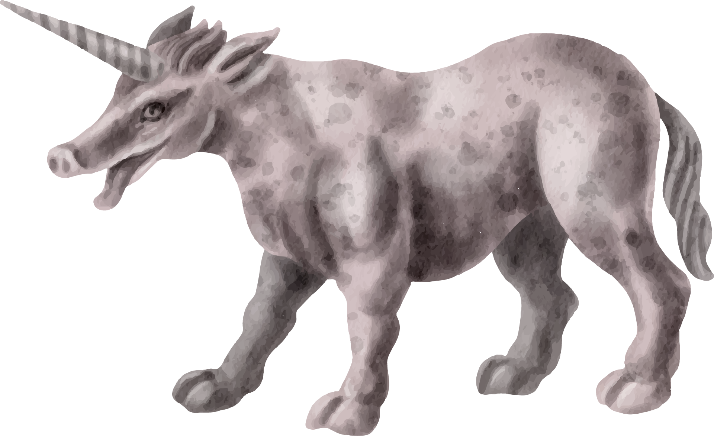
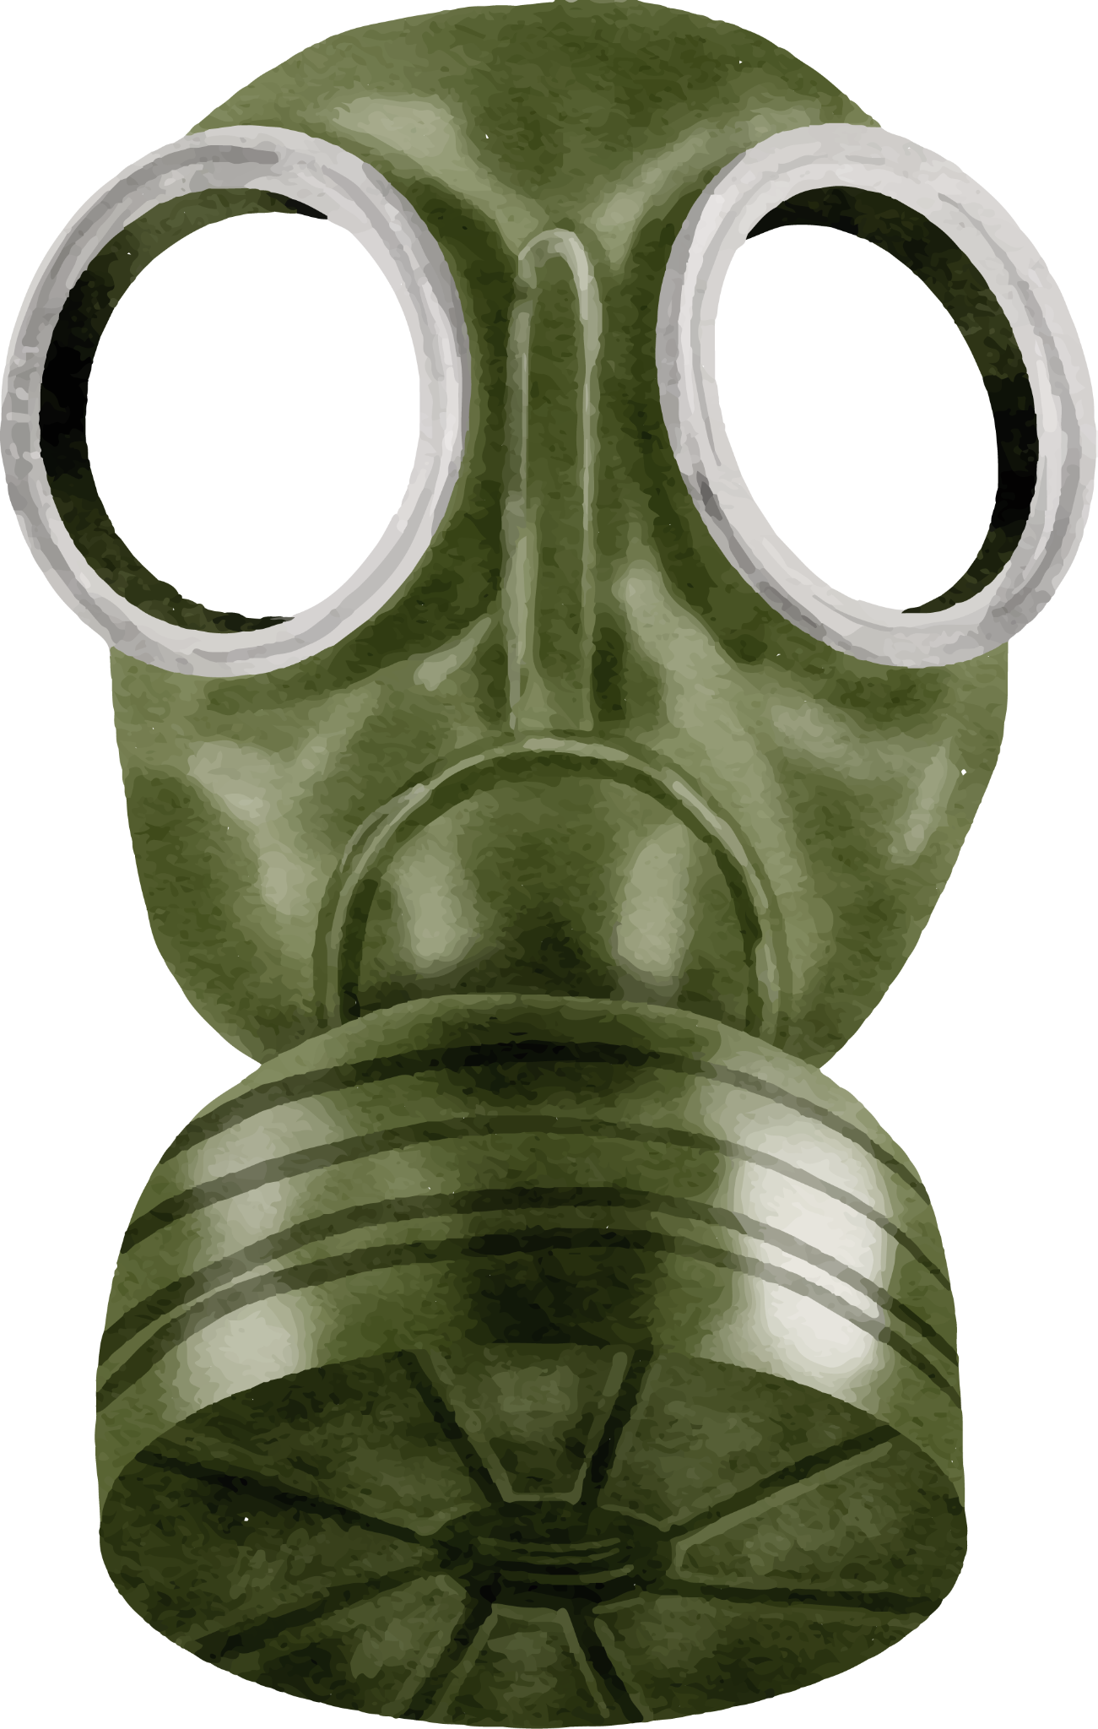
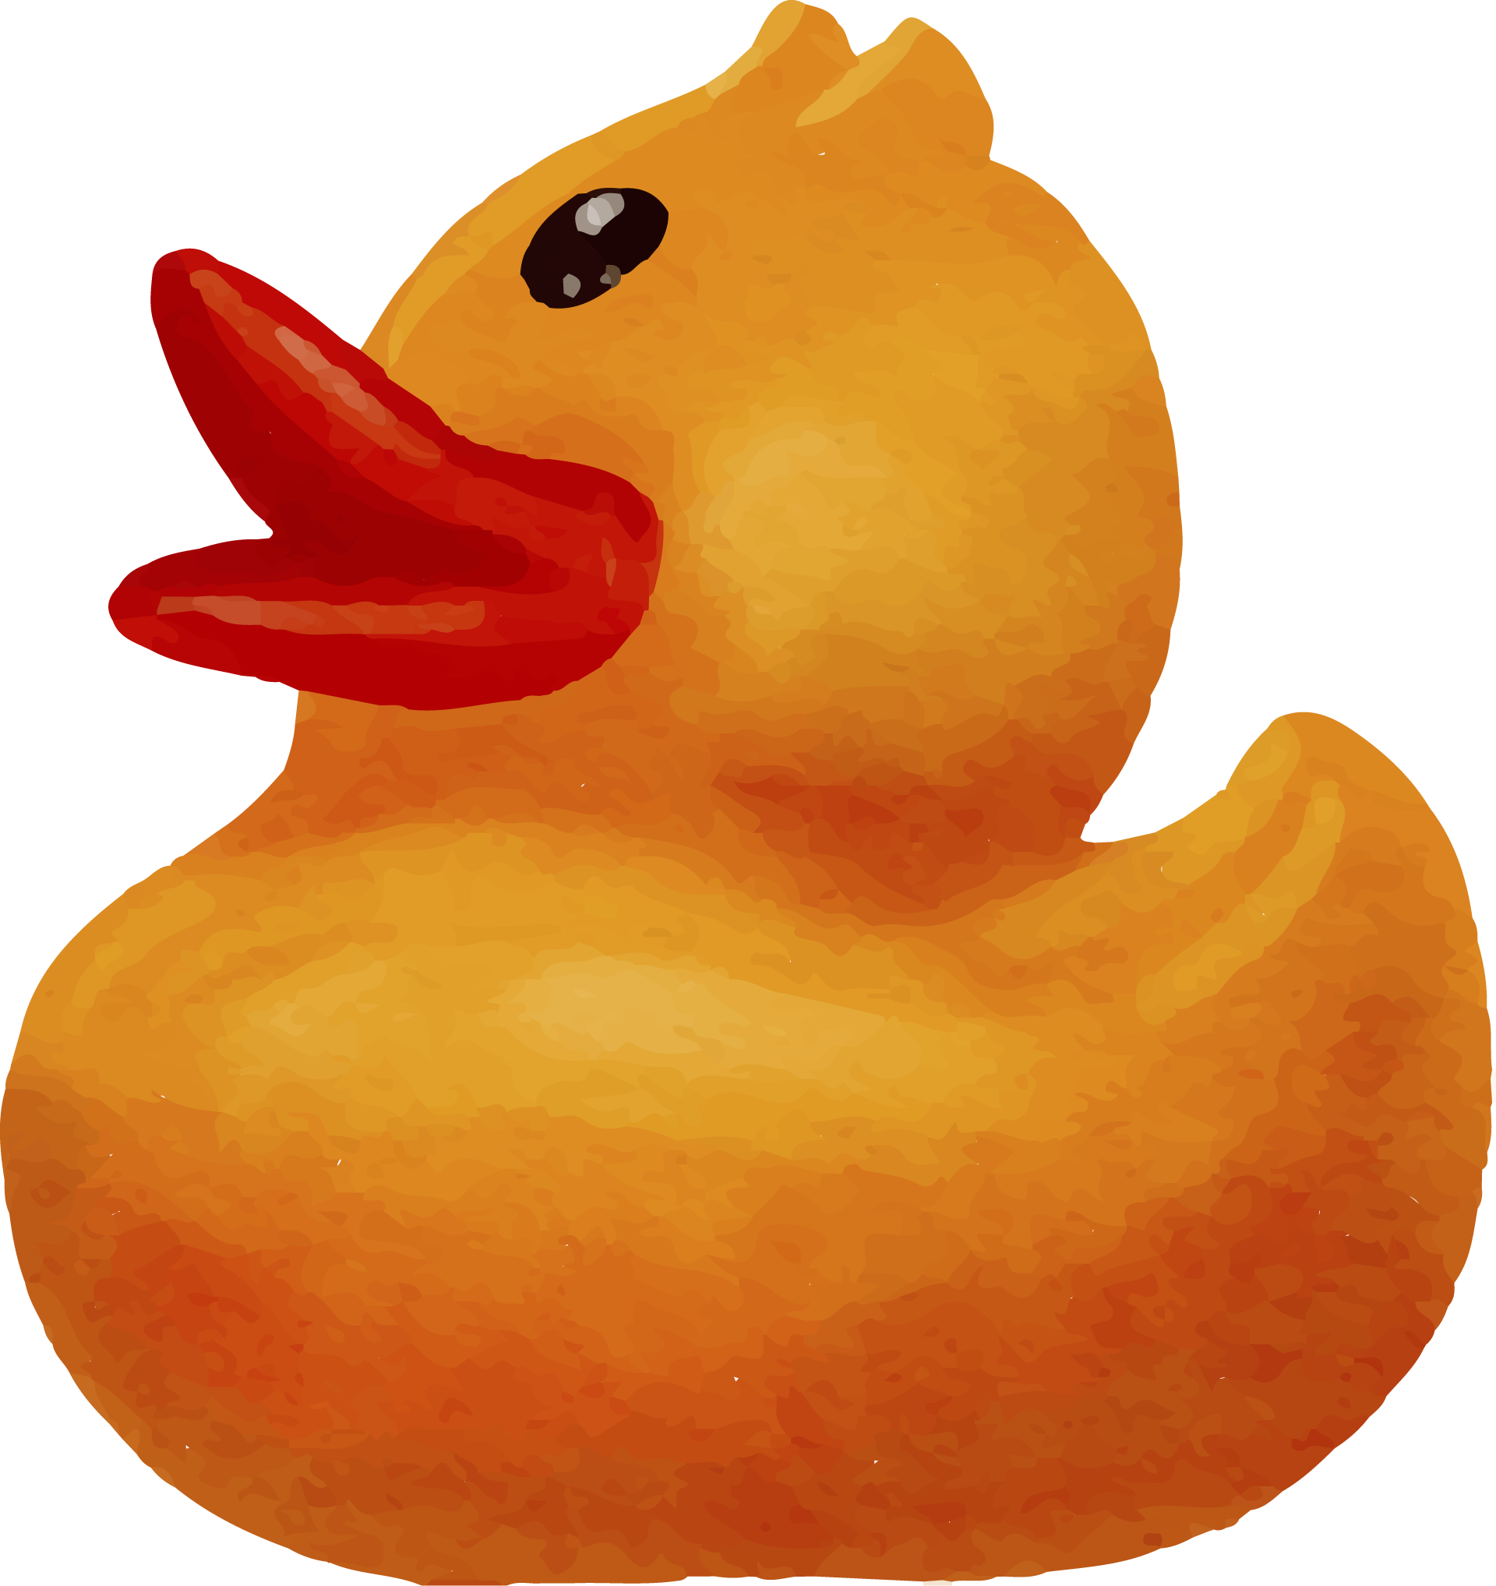
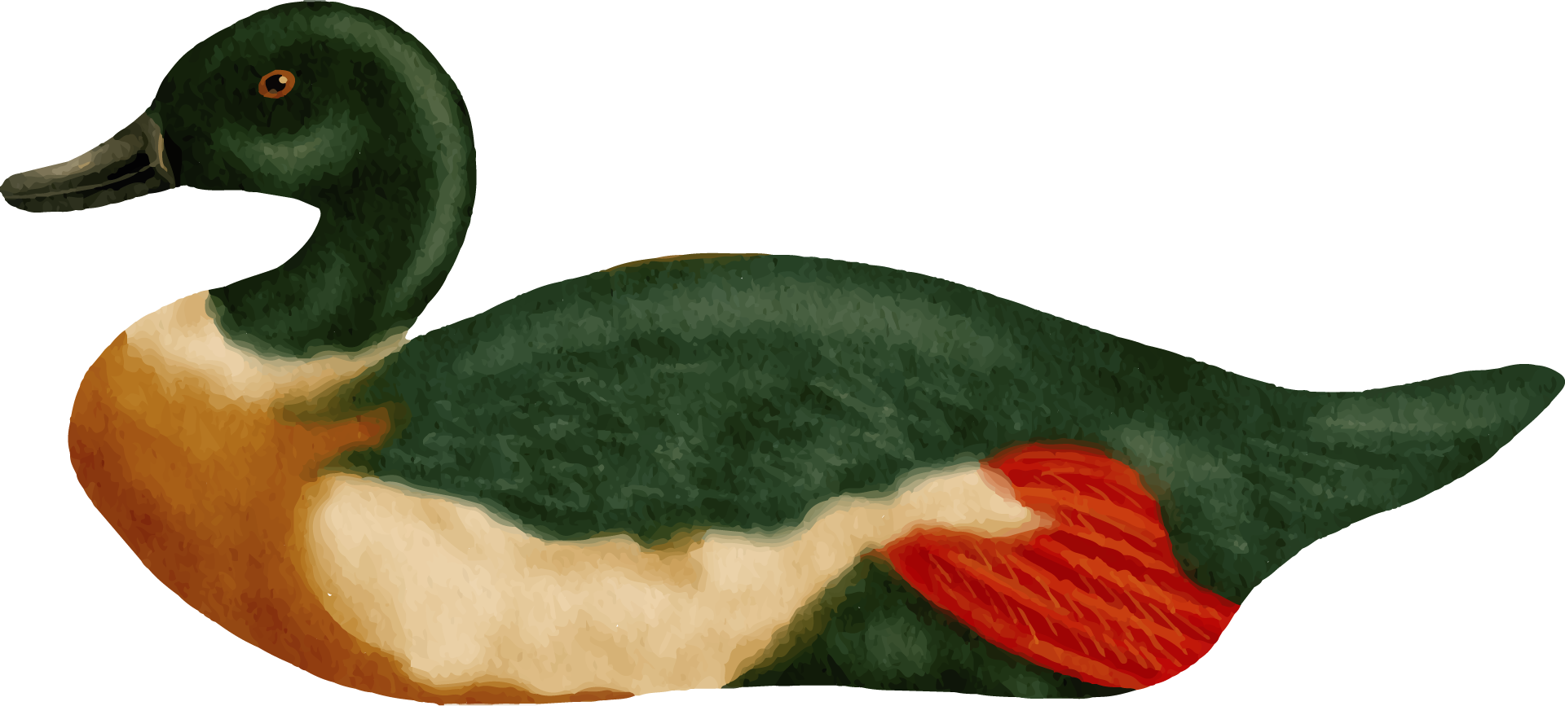
FUTURE EMPROVEMENTS
Add AI for single-player mode.
Build a graphical interface.
Introduce new game modes and rule variations.
Implement statistics tracking for players.
Notes:
Script: "As with any project, there’s always room for improvement. Here are some areas I’d like to expand on in the future:
AI for single-player mode: Currently, the game is for two players, but adding AI would allow players to enjoy a solo experience.
Graphical Interface: Moving from a console-based interface to a graphical one would make the game more visually engaging.
New game modes and rule variations: I’d like to introduce different game modes or variations of the rules to make the gameplay more diverse.
Statistics tracking: It would be interesting to track player performance across games, recording stats like wins, losses, and scores."

Slide 8

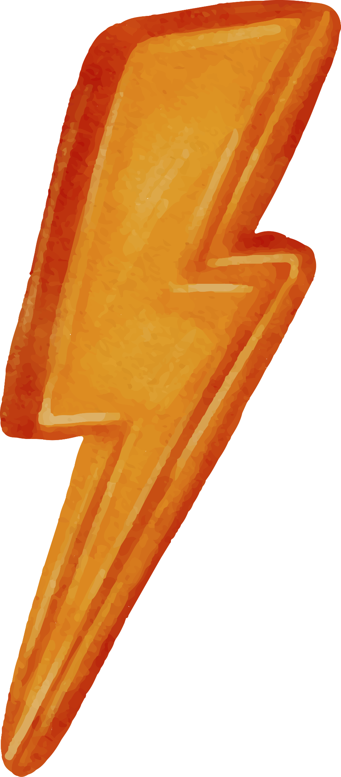
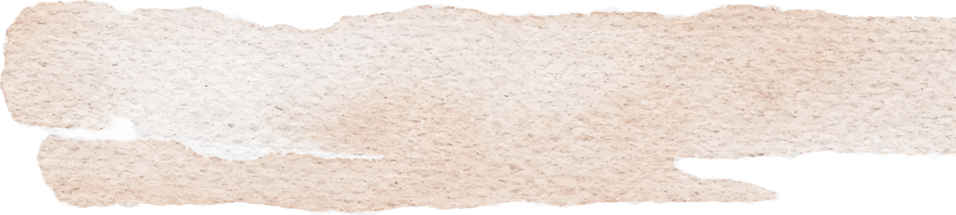
THANKS!
Notes:
Script: "Thank you for taking the time to review my project. I hope you found the design and implementation of this two-player domino game interesting. If you have any questions or would like to discuss any part of the project further, feel free to ask now. I’d be happy to dive deeper into the technical aspects or the gameplay mechanics. Thank you again!"

